Slide 1
Augmented Reality for students and learning enthusiasts
Shri Shankaracharya Institute of Professional Management & Technology, Raipur
Major Project(Phase-I) Report on
CSE 7th Semester
Department of Computer Science and Engineering,
Batch 2019-2023
Session July – Dec 2022
Presentation Date: 24-01-2023
Project Group Members:
Shreesh Gupta, 303302219096
Shreya Gupta, 303302219129
Sanjeevani Sandeep Verma, 303302219128
Project Guide
Yogesh Kumar Rathore
(Asst. Professor, CSE)

Slide 2
Introduction about Project
Augmented reality (AR) is an evolving technology that has the potential to revolutionize how we learn and understand complicated concepts. AR combines real-world objects with virtual information to create a hybrid world in which technology meets reality. This allows pupils to study complicated concepts in a more pleasant and simple manner. Our application facilitates the understanding of complicated schematics by using three dimensional models and accompanying video explanations. The software also has interactive features that allow learners to effortlessly connect with the application. This makes learning more fun and engaging, while also helping pupils to better understand the concepts that they are studying.

Slide 3
Applications & Benefits
Learning resources are available at all times and from any location. It offers mobile and low-cost learning resources. Education becomes more portable and accessible as a result.
There is no requirement for specialised equipment. The majority of the target population can use AR technology right away.
AR learning maintains students’ interest throughout the course and make learning enjoyable and simple.
AR gamification attempts to enhance the overall learning process of youngsters with intellectual disability. It provides a game-based learning system.

Slide 4
End Users
School students
College students
Anyone interested

Slide 5
Literature Review
Augmented reality (AR) is a technology that superimposes computer-generated elements onto a view of the real world, and has the potential to enhance the learning experience for students.
Studies have shown that AR can improve student engagement, motivation, and understanding of concepts.
Research suggests that AR can be particularly beneficial for visual learners.
AR has been used in a variety of educational settings, including subjects such as biology, chemistry, mathematics, medicine, history, and engineering.

Slide 6
Literature Review
A systematic review has revealed that AR is effective in increasing motivation and facilitating interaction.
Despite the potential benefits, implementation of AR in education is still in early stages and further research is needed to understand its full impact on student learning.
Challenges in implementing AR in education include cost, accessibility, and the need for teacher training to effectively use the technology in the classroom.

Slide 7
Problem Identification
According to research, most of us are visual learners — we learn and understand concepts best when provided with visual cues.
Augmented reality is therefore a great enabler of learning experiences, especially with the growing capabilities of this technology.
The rendering of objects has improved, along with the ability of 3D models to react to the environment in which they’re projected.
A systematic review of a decade of using AR in education has revealed that augmented reality is “increasing motivation (24%) and facilitating interaction (18%).”

Slide 8
Research Papers Reviewed
"Exploring the potential of augmented reality for enhancing teaching and learning in higher education" by J. L. Dominguez and D. M. G. Martinez (2016) - This study examined the use of AR in higher education and found that AR can be used to enhance teaching and learning through interactive, immersive, and authentic experiences.
"Augmented Reality in Education: A Study on Enhancing Learning Outcomes" by M. M. A. Al-Qershi and R. A. Al-Qershi (2017) - This study explored the use of AR in teaching English vocabulary to primary school students and found that AR had a positive impact on student learning outcomes.
"A systematic review of a decade of using AR in education (2008-2018)" by A. M. K. El-Bishouty and S. A. Al-Kassas (2018) - This systematic review of studies on AR in education found that AR has a positive impact on student motivation and interaction.

Slide 9
"The effectiveness of augmented reality in education: A meta-analysis" by J. Y. Kim and J. H. Lee (2019) - This meta-analysis reviewed studies on the use of AR in education and found that AR had a positive effect on student learning outcomes, motivation, and engagement.
"Augmented Reality in Education: A Review of the Literature" by Z. H. Majeed and H. A. Ali (2020) - This literature review examined the use of AR in education and found that AR has the potential to enhance student engagement, motivation, and understanding of concepts.
"Augmented Reality (2021)" - In this survey, researchers explored Virtual Reality and Augmented Reality within social learning spaces, such as classrooms and museums, while also extending into relevant social interaction concepts found within more reality based and social immersive media.
"Augmented reality applications as a digital learning innovation in response to the pandemic (2022) " - This paper discusses the potential of augmented reality applications to significantly improve college students’ learning abilities, and abilities to demonstrate practical understanding, in the context of the COVID-19 pandemic. This paper intends to address gaps in knowledge by assessing students’ attitudes toward digital learning via augmented reality applications.

Slide 10
Project Requirements(Developer)
Software’s Required (With Versions duly mentioned)
Google AR core API
Android min SDK version
Android 7.0 and unity 2021.3.4
Vuforia 10.7
Hardware Required
Nvidia Geforce RTX 2070 Super
CPU with a minimum clock speed of 3.5Ghz
SSD with 256GB storage
8GB Ram

Slide 11
Project Requirements(End User)
Software’s Required (With Versions duly mentioned)​
Android 7.0​
IOS 9​
Hardware Required​
Any modern smartphone with camera

Slide 12
Database Details
How Many Databases?​
One ​
Image storing database​
How Many Tables?​
One​
3d models along with their image targets​

Slide 13
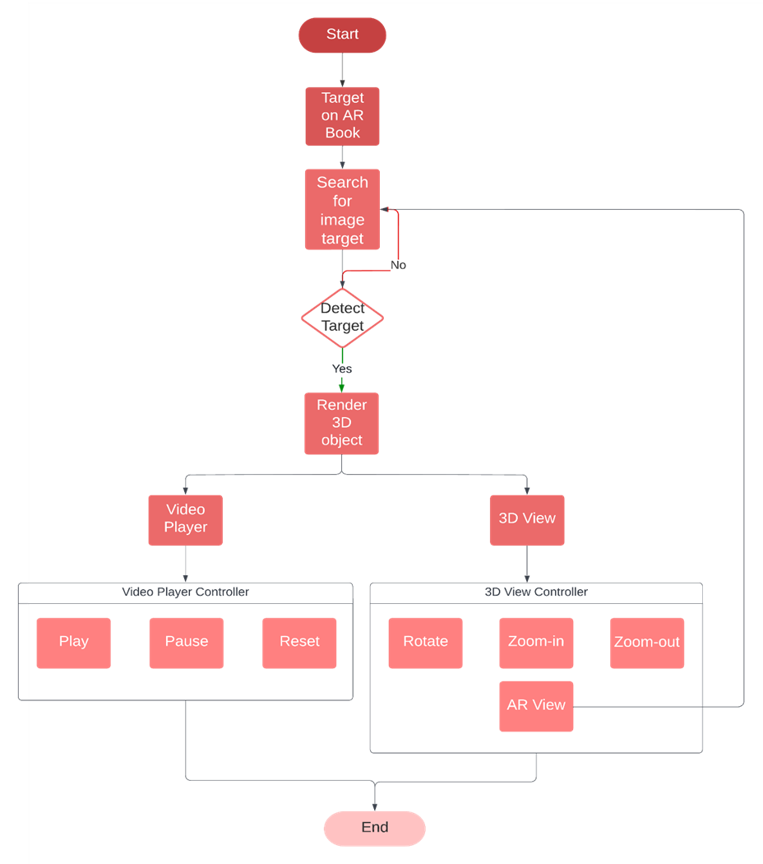
Project Workflow Diagram

Slide 14
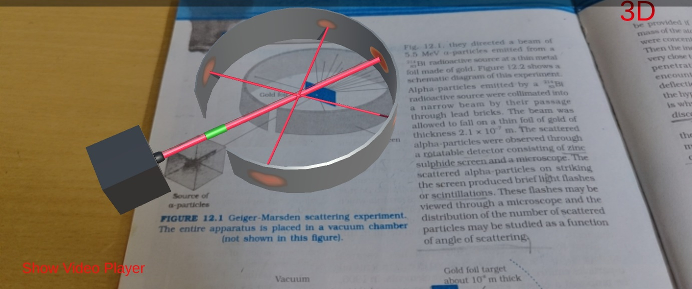
Snapshots
Figure 4.1 Three dimensional representation of Rutherford model over the image alongwith “Show Video Player” and “3D” options

Slide 15
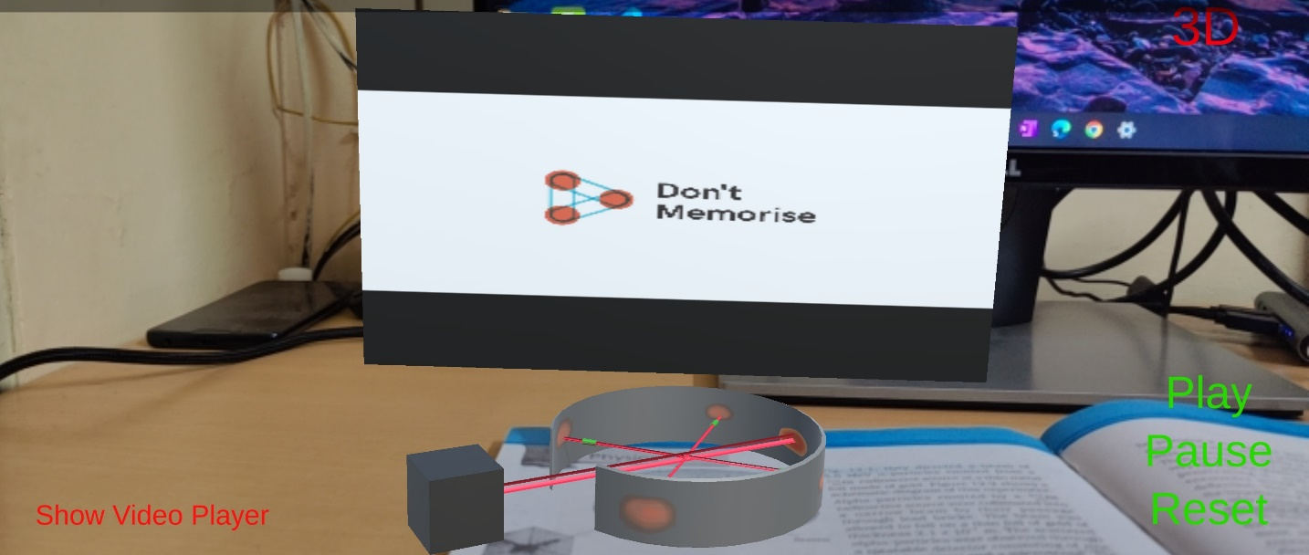
Snapshots
Figure 4.2 Showing video corresponding to the model and “Play”, “Pause” and “Reset” options

Slide 16
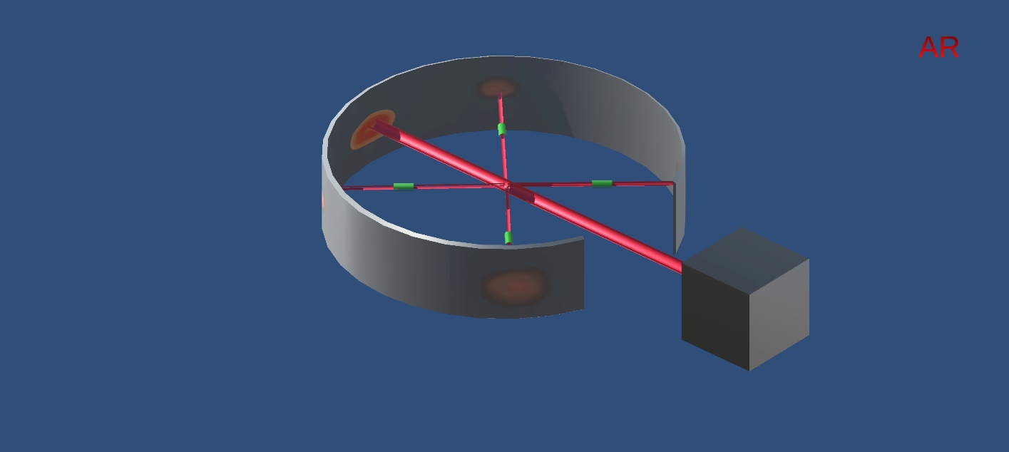
Snapshots
Figure 4.3 Three dimensional representation of the Rutherford model alongwith back to AR mode

Slide 17

Video Demonstration
DEMO VIDEO

Slide 18
Conclusion
AR allows teachers to assist students in grasping complex topics.
Because AR allows lecturers to display three dimensional representation of images and incorporate interacting components which makes textbook materials more interesting, any institute will be remarkable and more engaging.
Through the use of the application developed, students will get a better interacting way of learning and memorizing information.

Slide 19
References
Web Resources​
https://developers.google.com/ar/develop​
https://docs.unity3d.com/Manual/index.html​
AR in education
https://en.wikipedia.org/wiki/Augmented_reality
https://github.com/Shreesh-Coder/Minor-Project
​

Slide 20

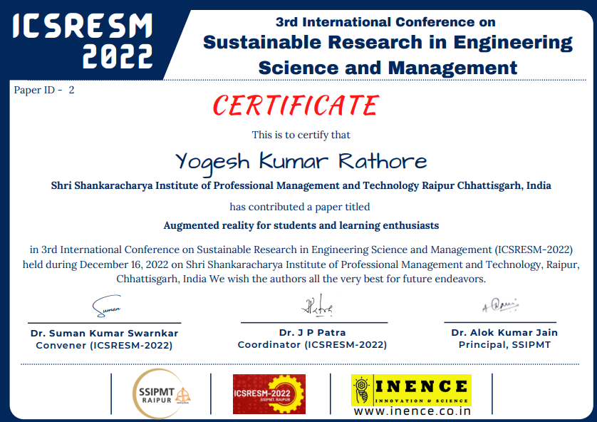

Slide 21
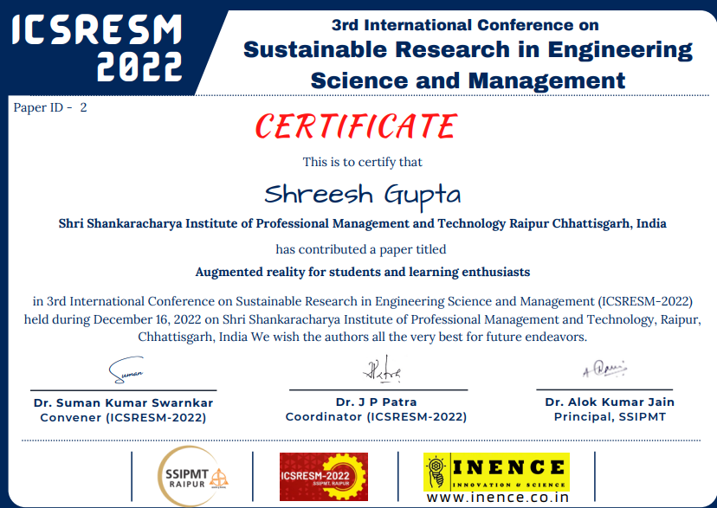

Slide 22
